Slide 1

Attendance Server
EECE 351 Project
Group 1

Slide 2
Presentation Outline
Our Experience
Initial approach
Multiple approaches
The Final Product
Databases
Server Code
GUI
Deployment

Slide 3



Writing a multithreaded server and client code
Initial Approach
We were able to have a working multithreaded server/client code interacting with the MySQL database
The code outputs results of queries in the console
We found difficulties to link this code with a UI

Slide 4
We tried multiple approaches including these areas
Multithreaded Client/Server (fully working code)
Jswing (fully working code)
PHP (Incomplete Login form)
Rest (Incomplete code)
HTTP Servlets (Part of the final version)
JSP (Part of the final version)

Slide 5
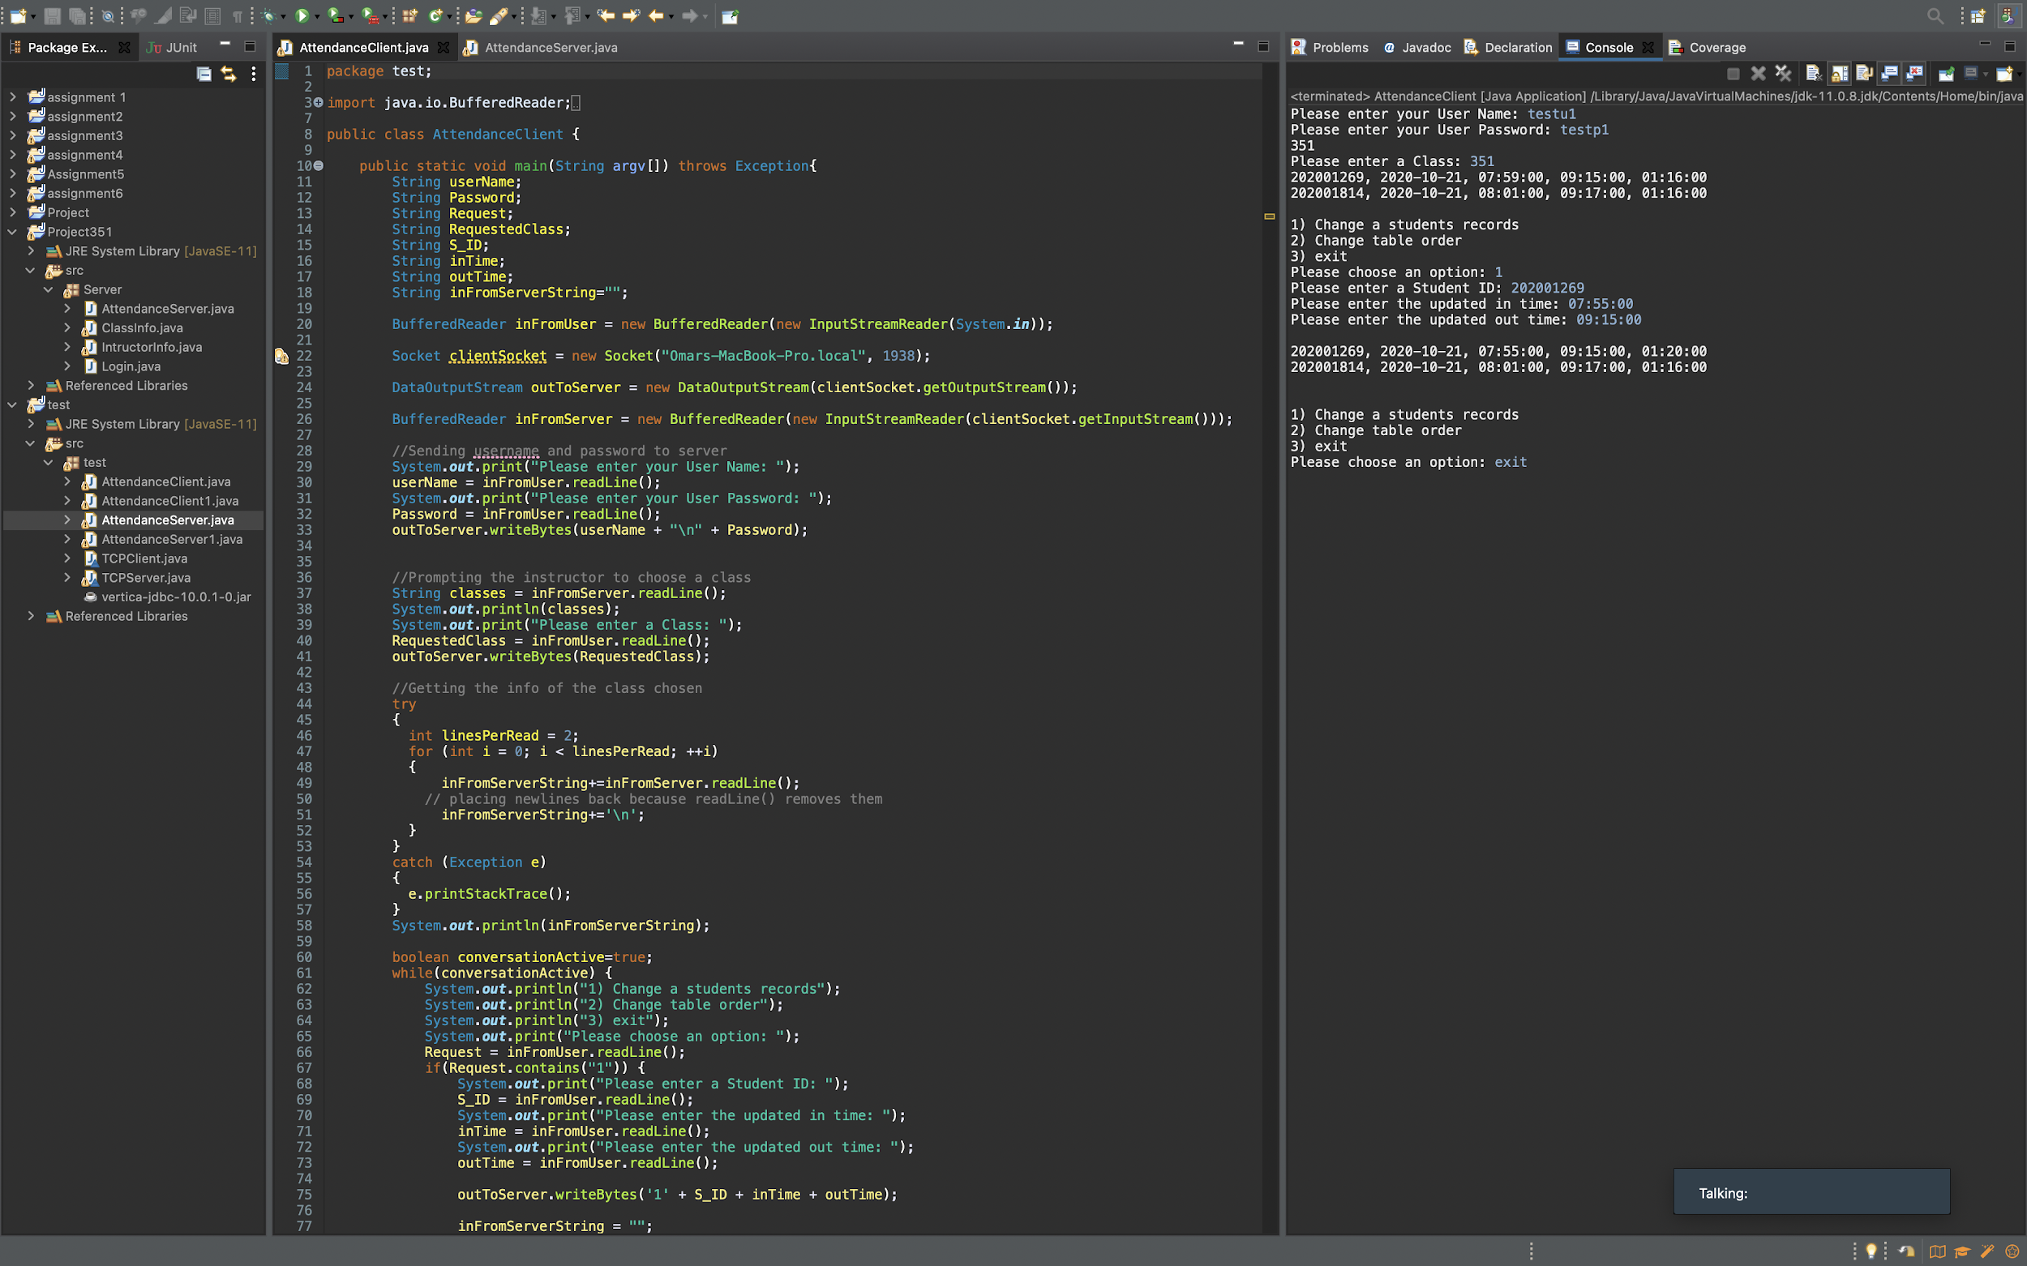
Multithreaded Client/Server

Slide 6
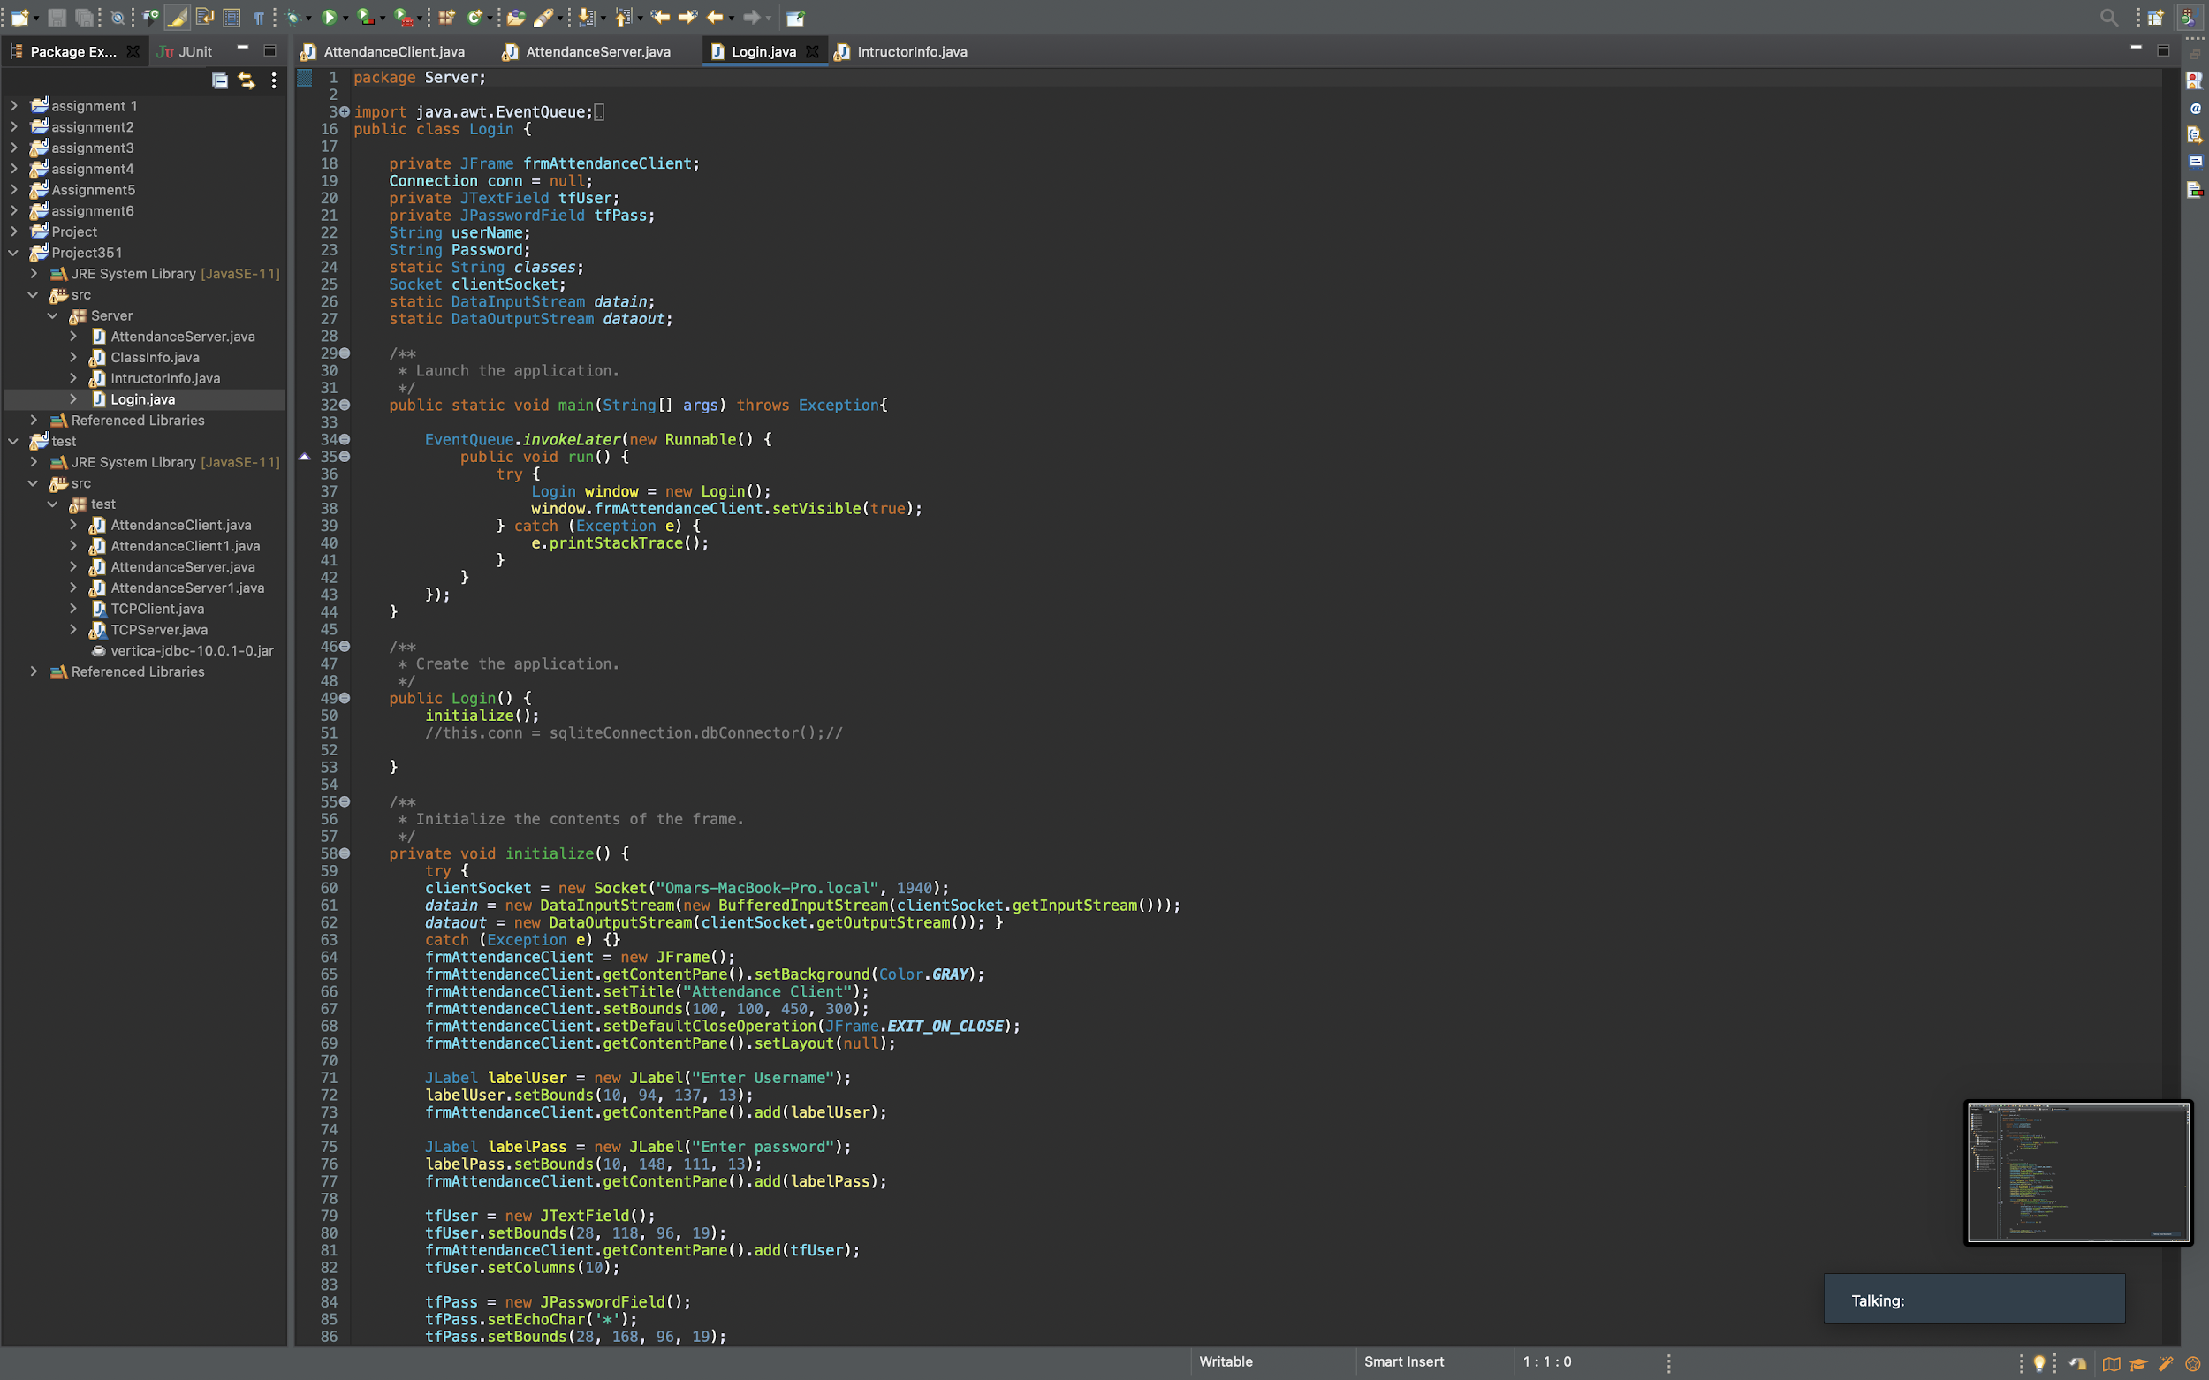
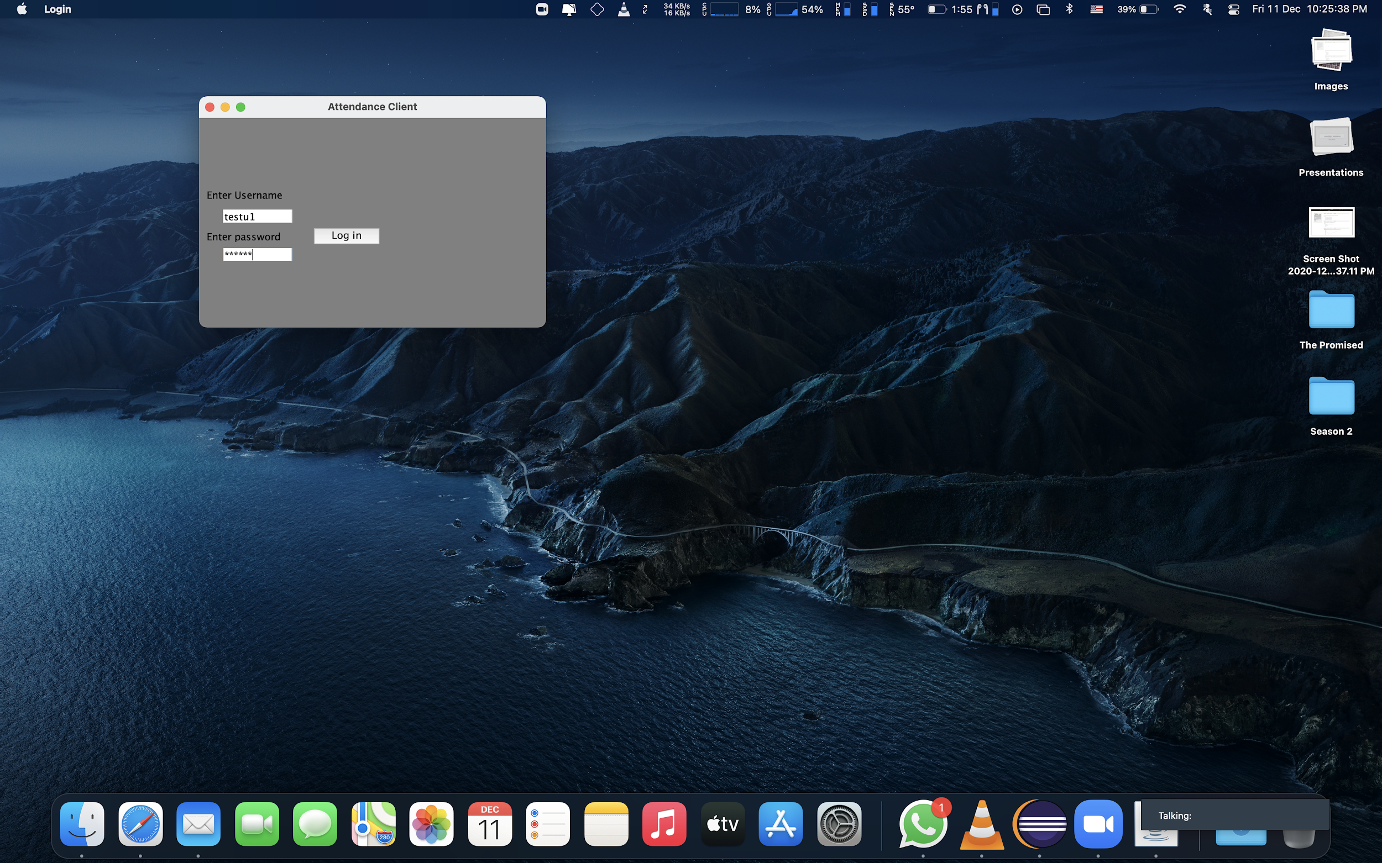
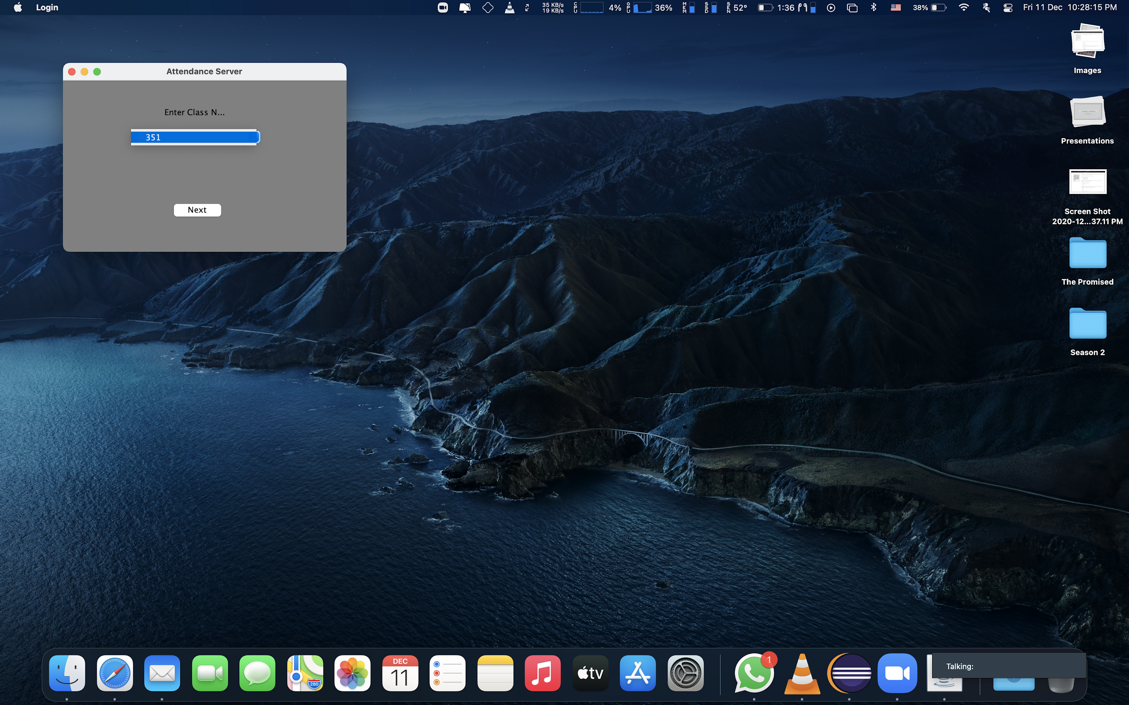
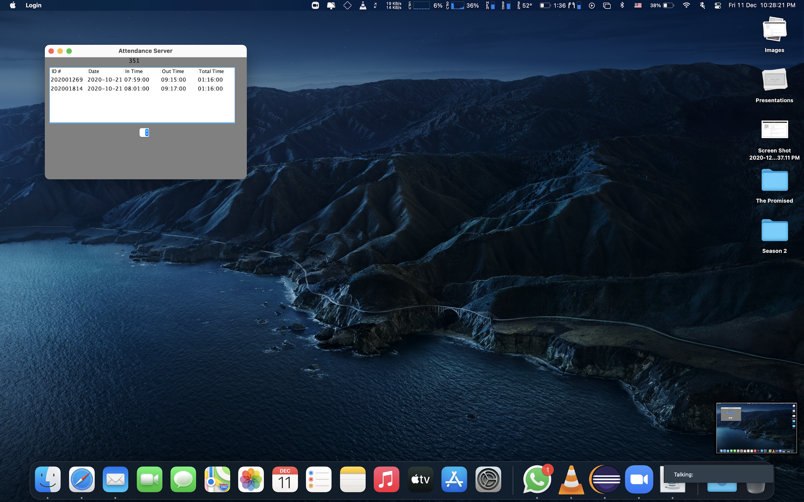
Jswing

Slide 7
HttpServelts and JSP (hosting on tomcat)
We ended up choosing this options for our final product
(code explained in the second part of the presentation)

Slide 8
The submission file includes the following attempts
Client-Server
Jswing
Multithreaded HttpServer (incomplete)
Our Final product, using JSP + HttpServlet

Slide 9
The Final Product
We found the combination of JSP and HTTPServlet to be the most convenient solution:
Intuitive
Easy to interract with UI
Multithreaded

Slide 10
1. The databases
EECE351_StudentAttendanceDB
EECE351_InstructorRecordsDB
StudentAttendance
InstructorClasses
IntructorCredentials
ON THE CLOUD (35.242.255.30:3306)

Slide 11
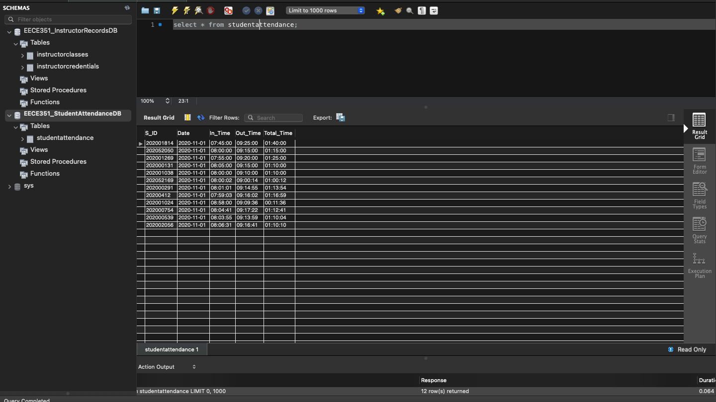

Slide 12
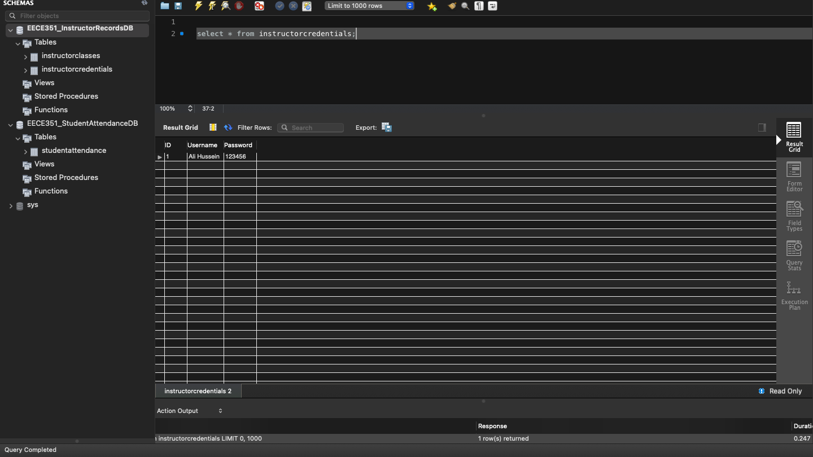

Slide 13
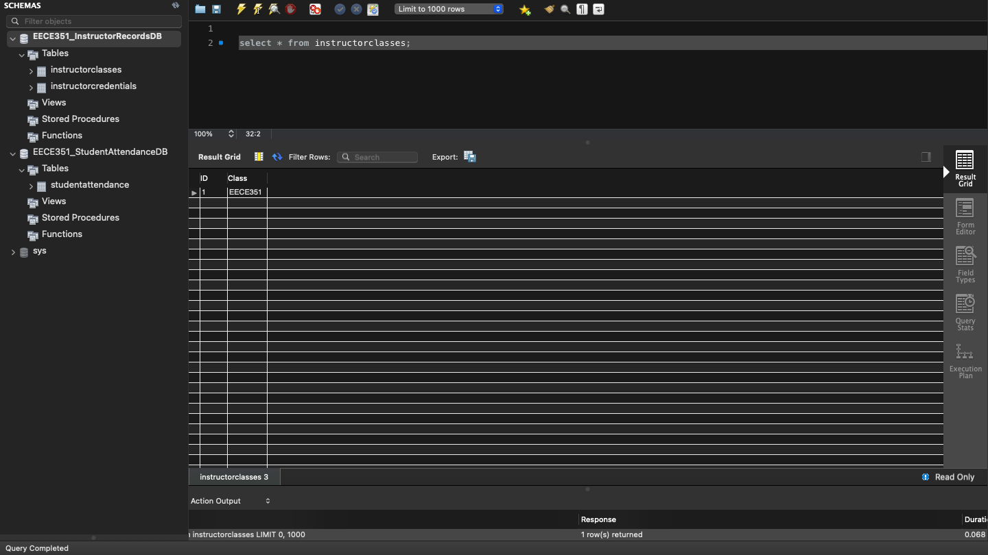

Slide 14


2. The Java Code
Java Resources:
LoginCheck.java
LogoutFunc.java
getClass.java
Tool.java
addStudent.java
removeStudent.java
updateTime.java
sortStudents.java

Slide 15
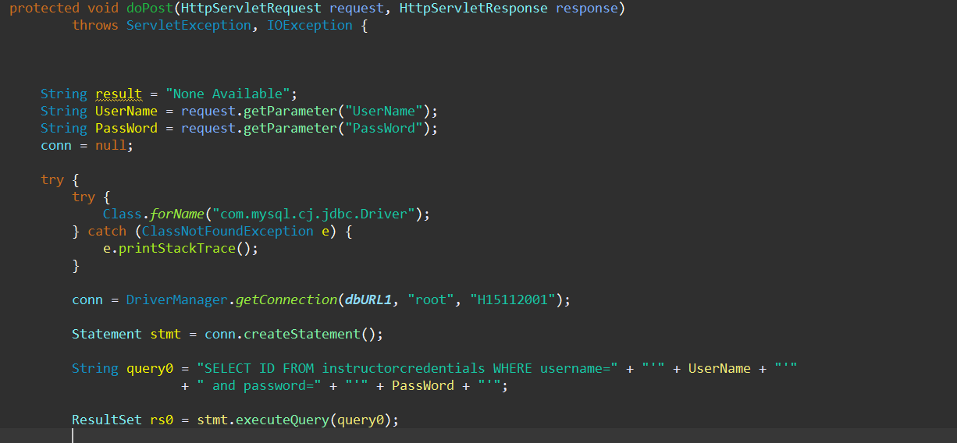
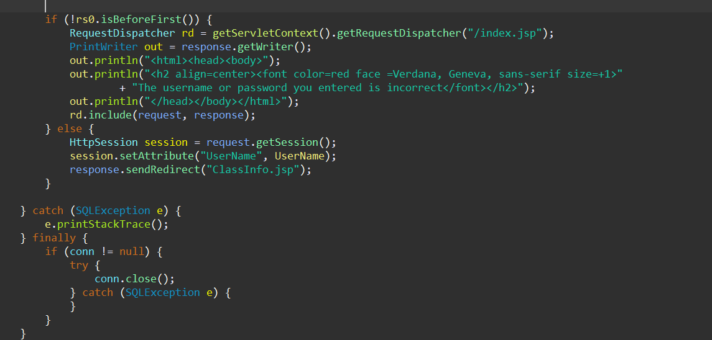
LoginCheck.java
This function is the first function to run. It checks if the credentials entered match with the InstructorRecordsDB
If the credentials match:
The user is redirected to the class info page
If the credentials don’t match: the user is redirected into the loginpage once again with a warning message

Slide 16
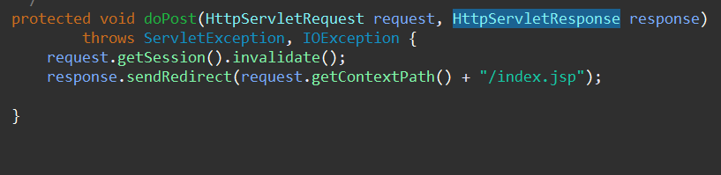
LogoutFunc.java
This function is the function for the logout button.
It kills the current session of the user and logs him out then redirects him back to the login page.

Slide 17
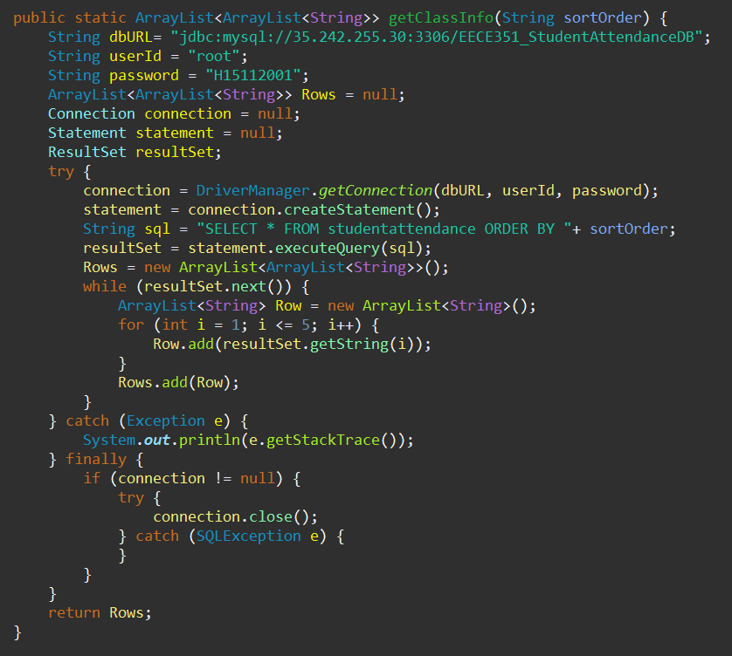
getClass.java
This function retrieves the ResultSet from the databases located on the cloud. (35.242.255.30:3306)
It returns an ArrayList of ArrayList<Strings> which can be interpreted as a table by the JSP file.

Slide 18
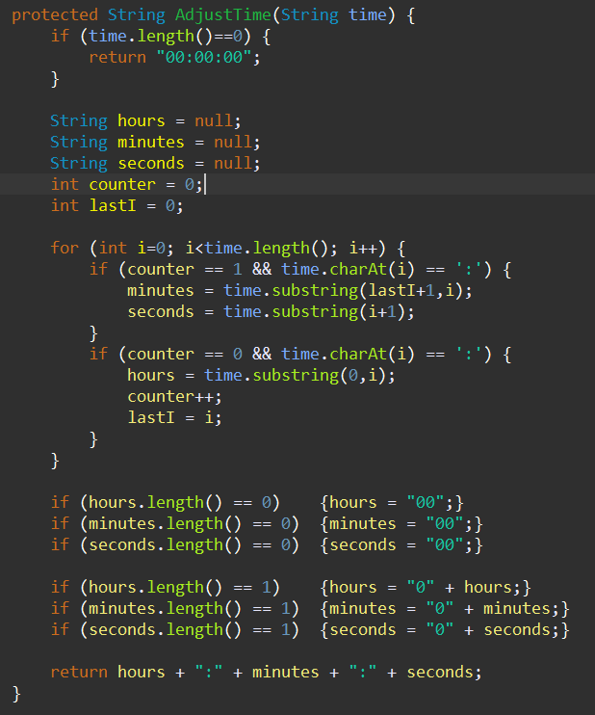
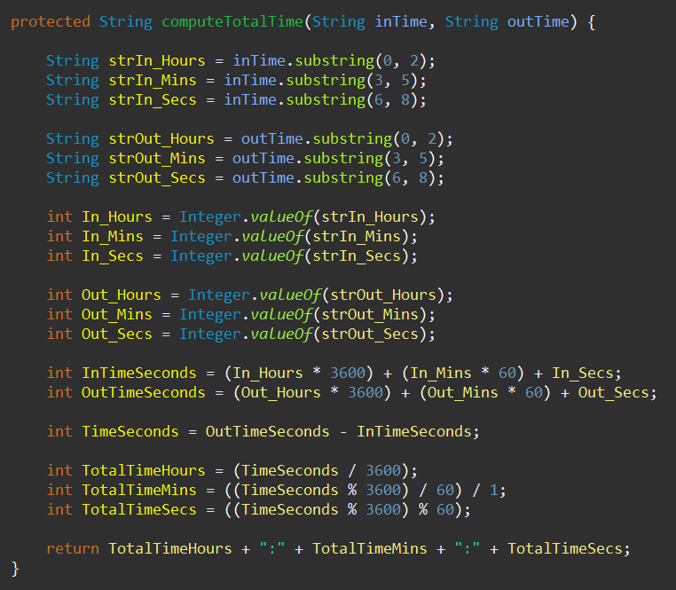
Tool.java
The tools class contains two functions that are used in multiple classes. the 1st one adjusts the format of the the time entered, incase the input was not entered correctly. The 2nd one computes the total time attended given an in time and an out time.
computeTotalTime works by converting the given in time and out time into integers. The function converts the times into seconds then finds the difference of the times to find the total time.
The time is then converted to the “hh:mm:ss” format so that it can be interpreted by MySql
AdjustTime works by checking if the format of the given time is correct (hh:mm:ss) or not.
If the format is not correct the function appends “0” where necessary so that MySql can interpret the date correctly.

Slide 19
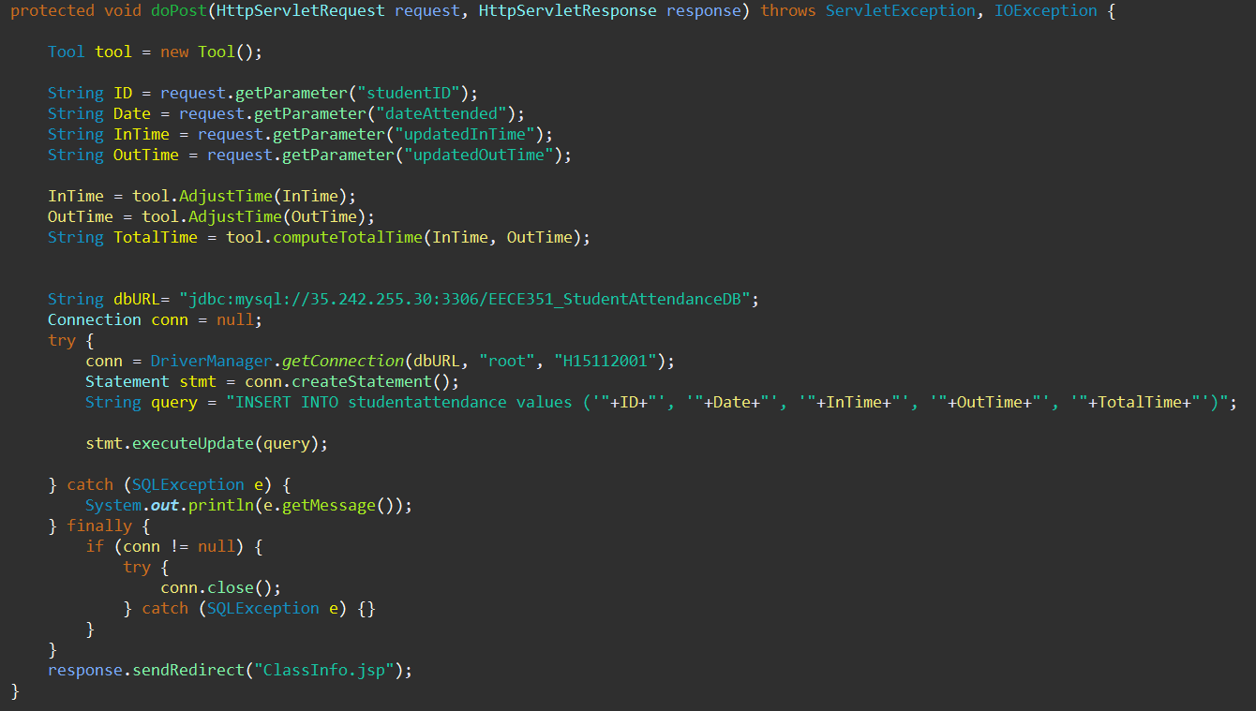
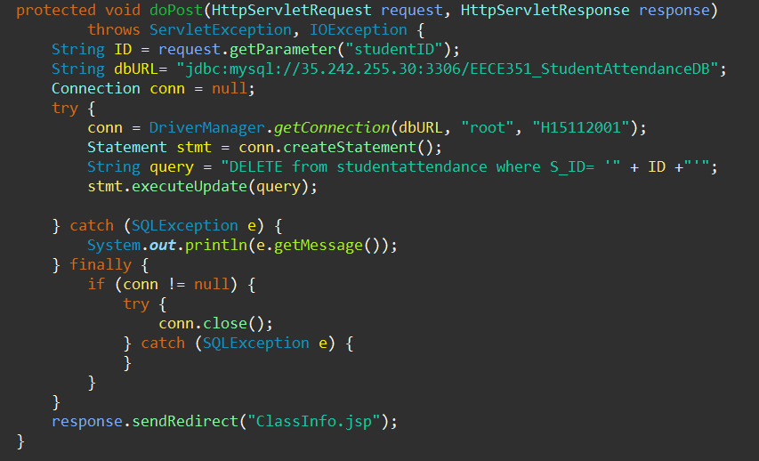
addStudent.java & removeStudent.java
These functions work by first establishing a connection to the MySql databases hosted on the cloud given the ip, username, and password of the database.
Then the functions handle the different requests of the user by executing either an INSERT query or a DELETE query depending on what functionality the user wants.
The database is then updated and after that, the user is redirected to the class info page where he can view the updated table.

Slide 20
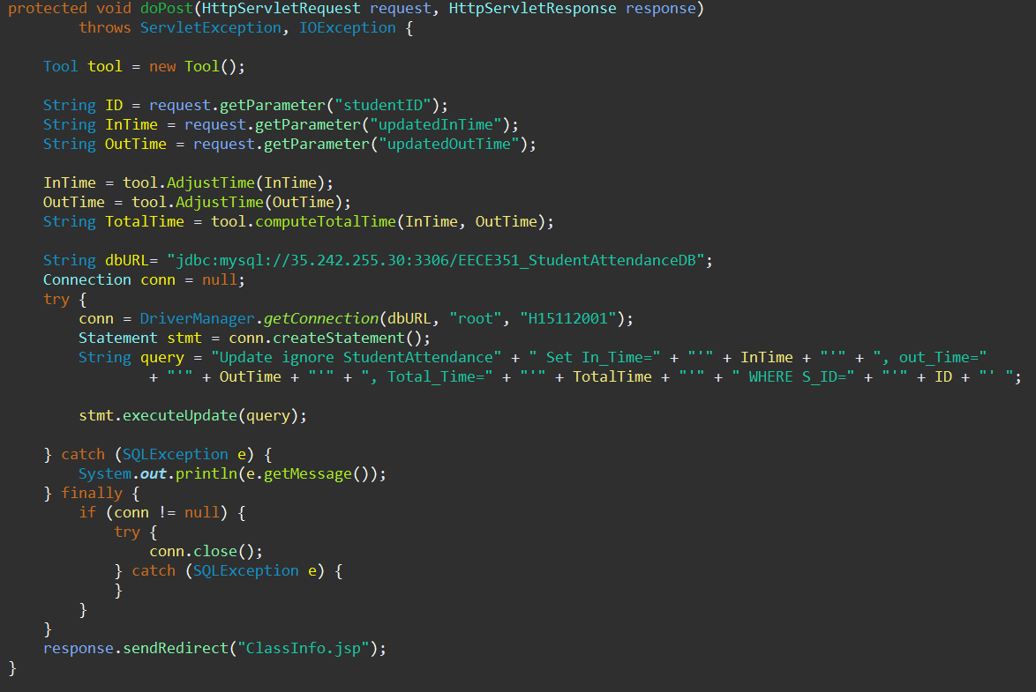
updateTime.java
This function starts by establishing a connection to the MySql databases hosted on the cloud given the ip, username, and password of the database.
Then, It handles the request of the user by executing the UPDATE query with the parameters given by the user.
The database is then updated and after that, the user is redirected to the class info page where he can view the updated table.

Slide 21
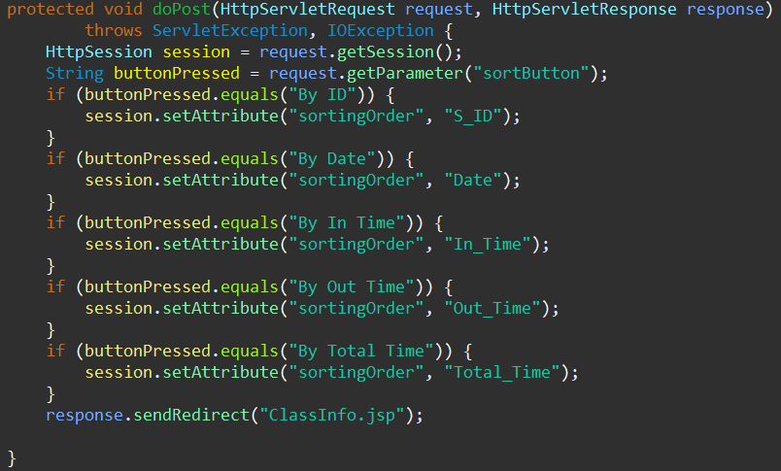
sortStudents.java
This function works by setting the sorting order which the getClass.java servlet uses.
The sorting order is chosen based on which button is pressed by the users on the class info page.

Slide 22

3. Web content + GUI
index.jsp (login page)
ClassInfo.jsp
JSP Resources:

Slide 23
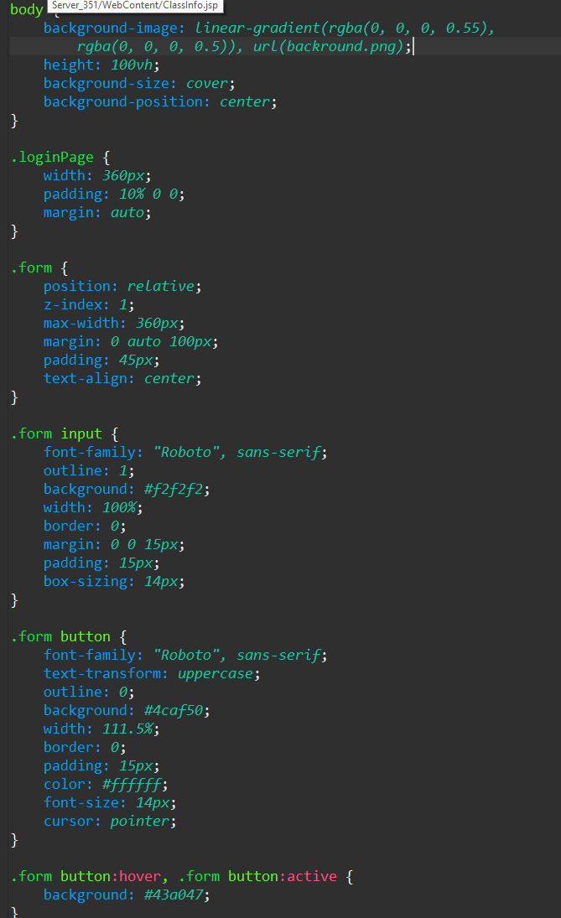
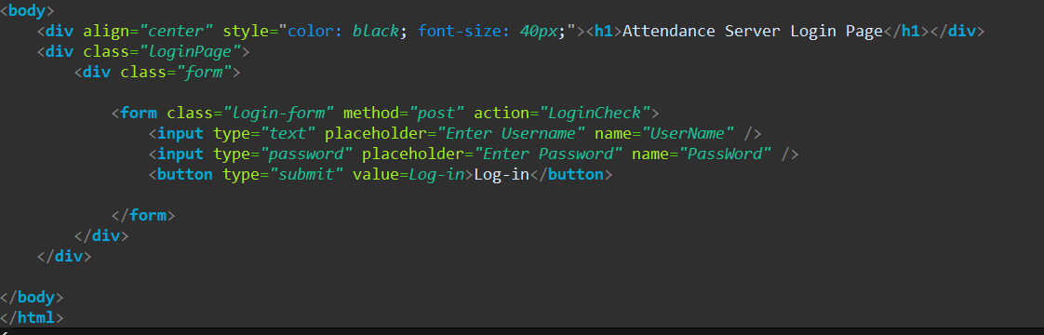
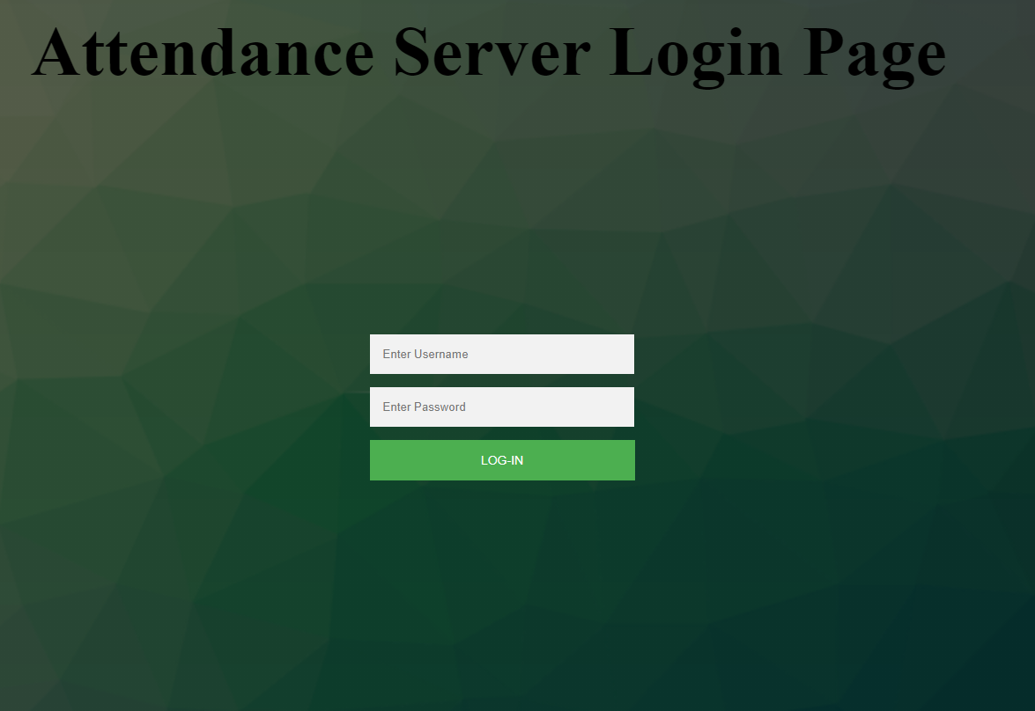
index.jsp
Styling snippet:
HTML code snippet:
Login Page:

Slide 24
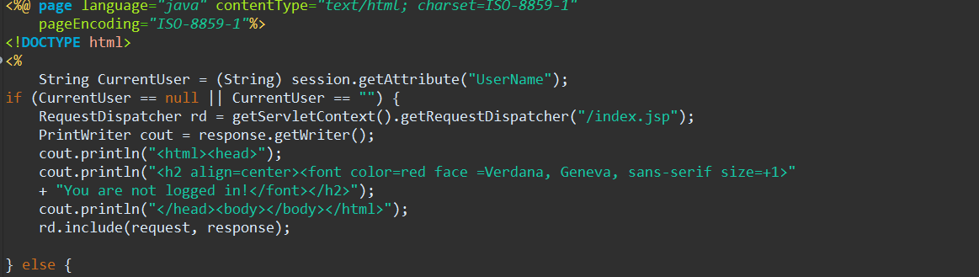
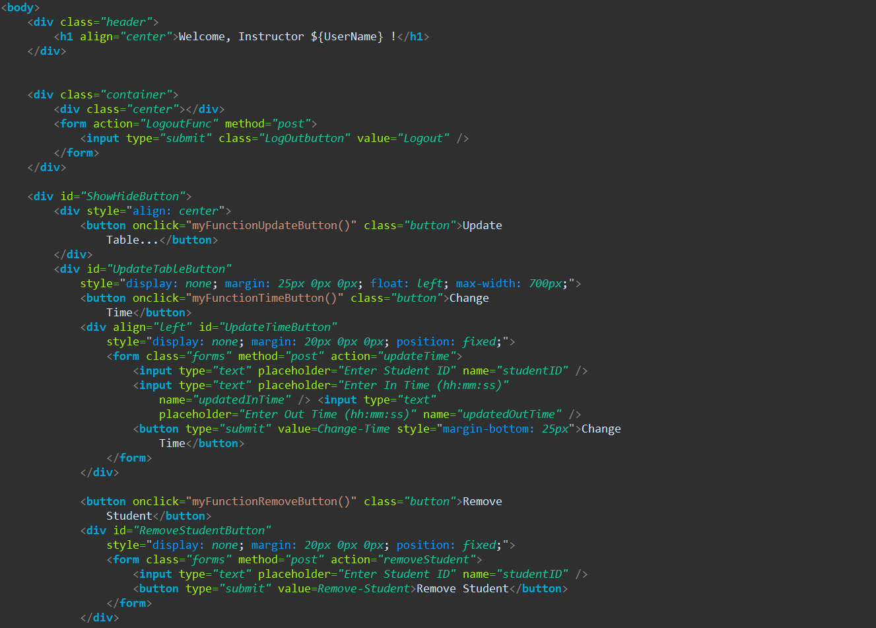
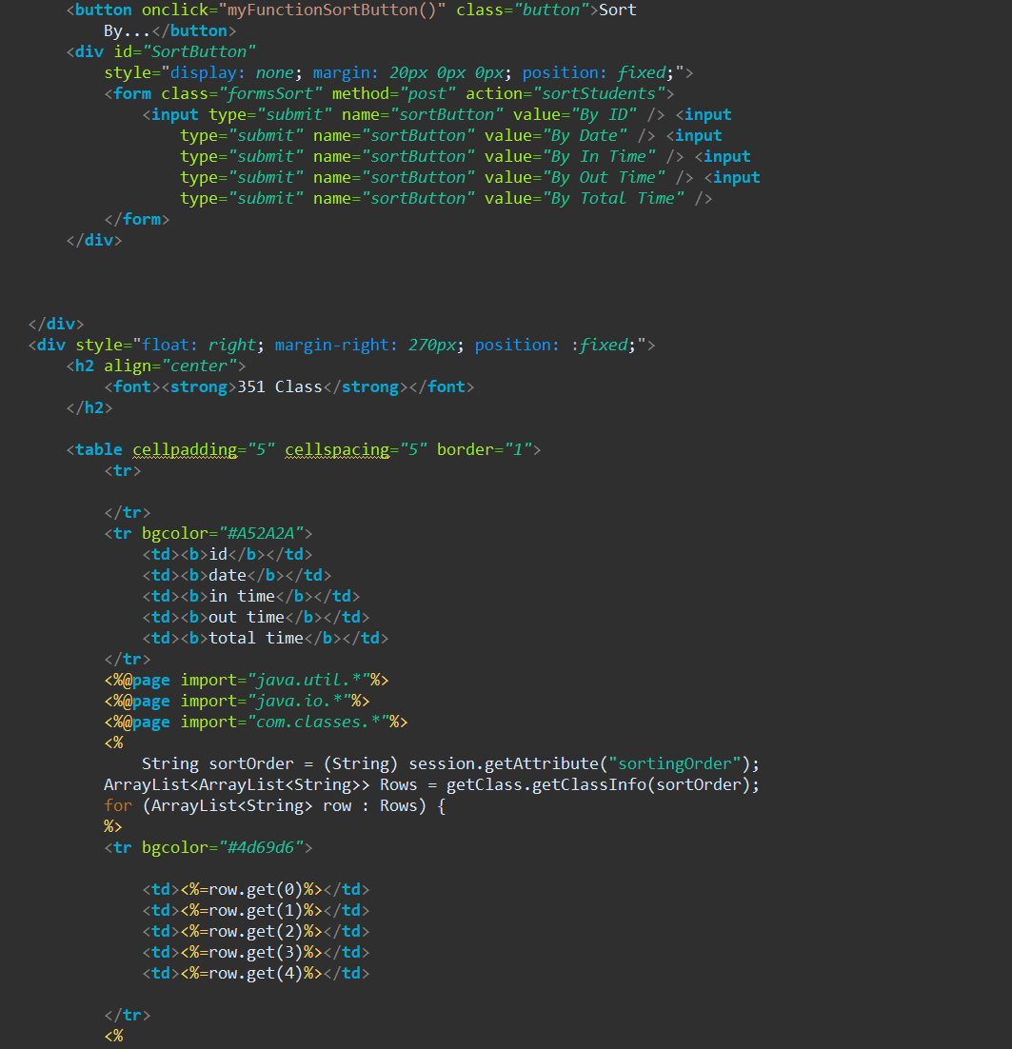
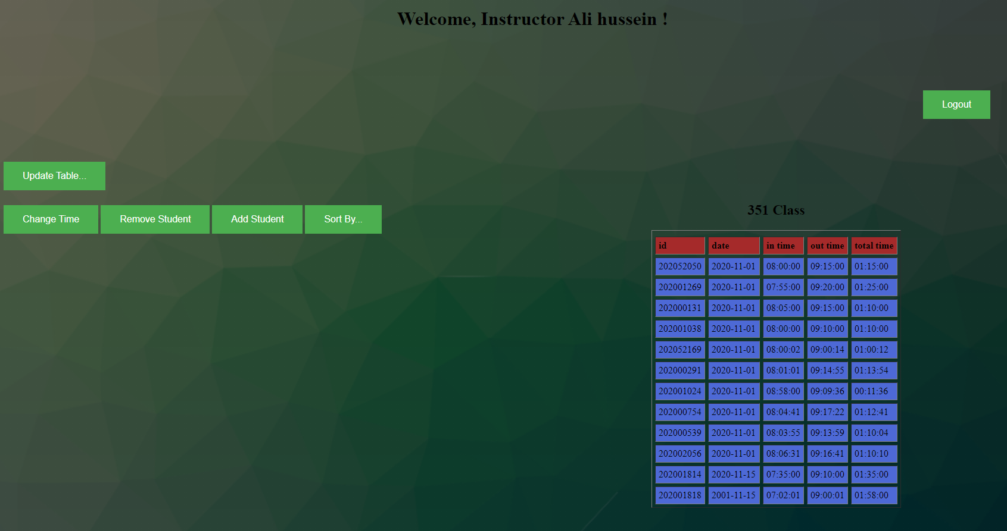
ClassInfo.jsp
For checking session authentication:
HTML Snippet of code:
HTML Snippet of code:
Full code available in the final version of the project included in the submission folder
Class Info Page:

Slide 25

4. Deployment
MySQL server deployment
Attendance Server project deployment

Slide 26
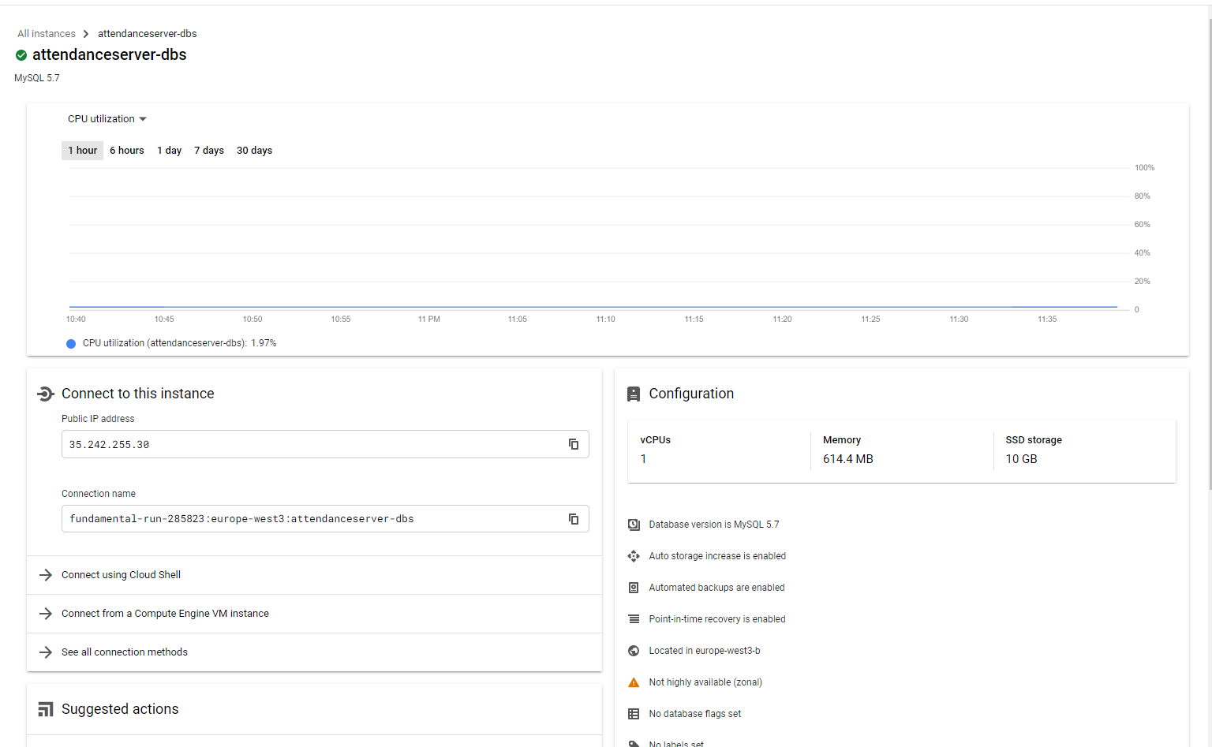
MySQL Server Deployment
For deploying the MySql database on the cloud we used the Google Cloud MySql service that lets us host databases that can be accessed remotely.
This enabled us all to collaborate on 1 set of databases rather than each member making his own locally and also allowed our web application to access the databases remotely.
This functionally is important because it makes sure that when the databases are updated by a client’s modification, the other clients who have access to that same database also receive the updated database in real time.
By using the URL: 35.242.255.30:3306 a client or a web service can access the MySql hosted on the cloud

Slide 27
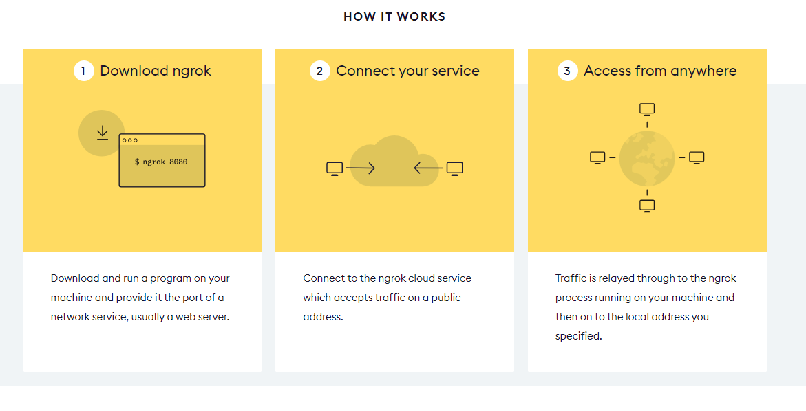
Attendance Server Deployment
We used the Ngrock cloud service for the deployment of our tomcat server.

Slide 28
Thank you!
Link For Website: http://6cda8e8022ea.eu.ngrok.io/Server_351/
Username: Ali Hussein
Password: 123456

